Slide 1

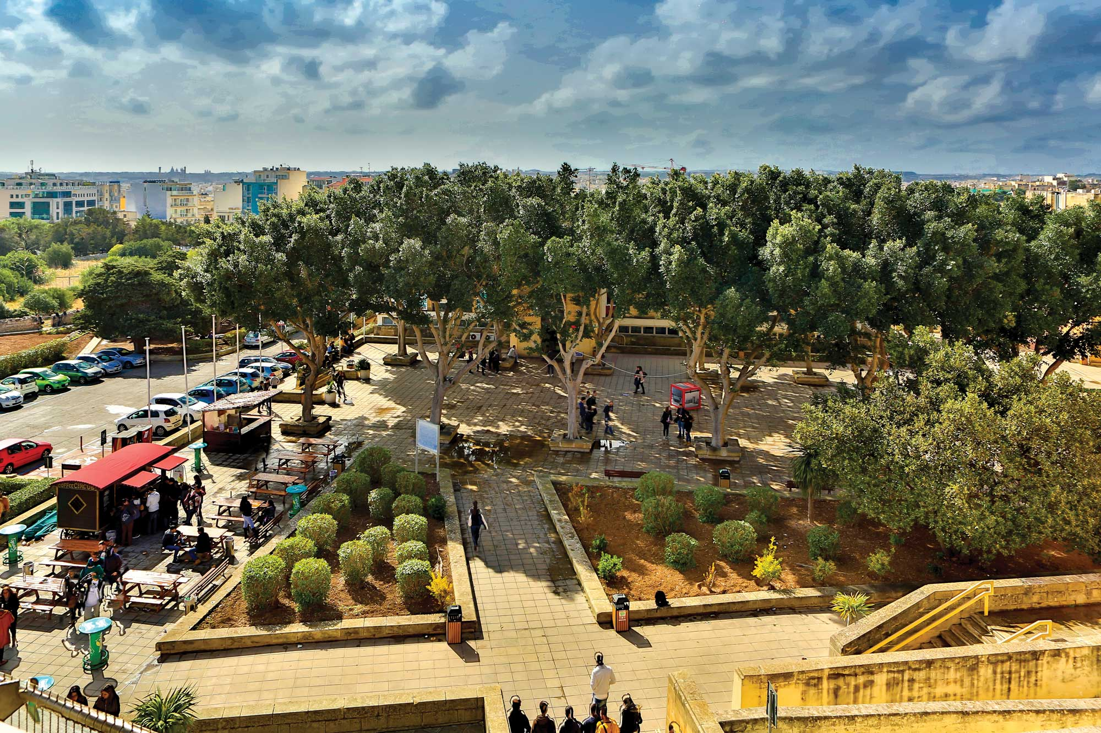



MALTAomics Summer School
Introduction to Multi-omics Analysis
Panagiotis Alexiou
ERA Chair,
Bioinformatics for Genomics in Malta
(BioGeMT)

Slide 2

The Blind Men and the Elephant
We have to remember that what we observe is not nature in itself, but nature exposed to our method of questioning.
Werner Karl Heisenberg

Slide 3



DNA
RNA
PROTEIN

Slide 4

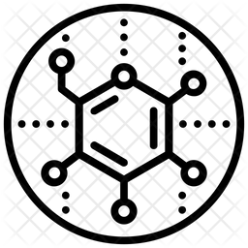
DNA
PHENOTYPE
RNA
METABOLITE
PROTEIN

Slide 5
DNA
Genomic Data
Epi-Genomic Data
PHENOTYPE
Transcriptomic Data
Phenomic Data
RNA
METABOLITE
Metabolomic Data
PROTEIN
Proteomic Data

Slide 6
DNA
Genomic Data
Epi-Genomic Data
PHENOTYPE
Transcriptomic Data
Phenomic Data
RNA
METABOLITE
Metabolomic Data
PROTEIN
Proteomic Data

Slide 7
Genomic Data
DNA
Epi-Genomic Data
PHENOTYPE
Transcriptomic Data
RNA
Phenomic Data
METABOLITE
Metabolomic Data
PROTEIN
Proteomic Data

Slide 8
Genomic Data
DNA
Epi-Genomic Data
PHENOTYPE
Transcriptomic Data
?
RNA
Complex Interplay
Phenomic Data
METABOLITE
Metabolomic Data
PROTEIN
Proteomic Data

Slide 9
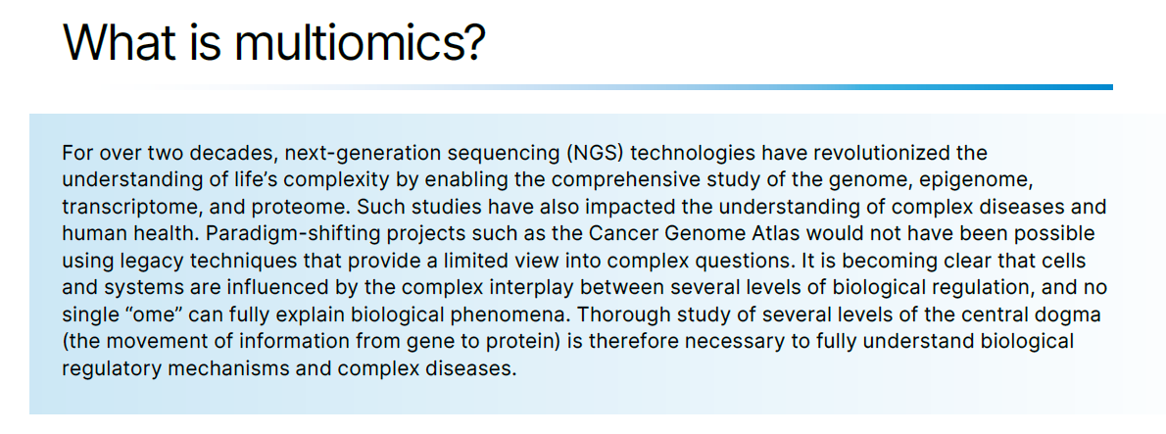
Multiomics: An overview of useful methods and applications – Illumina, 2023

Slide 10

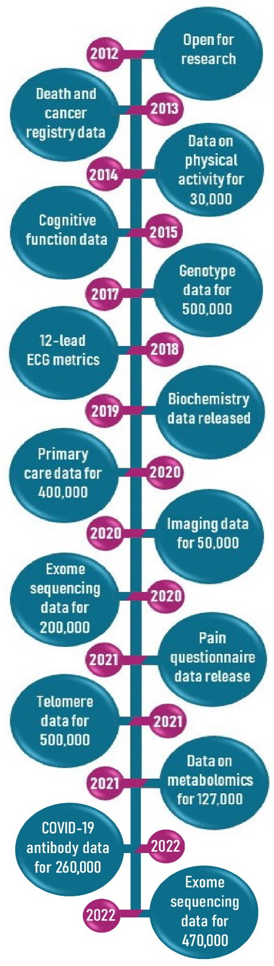
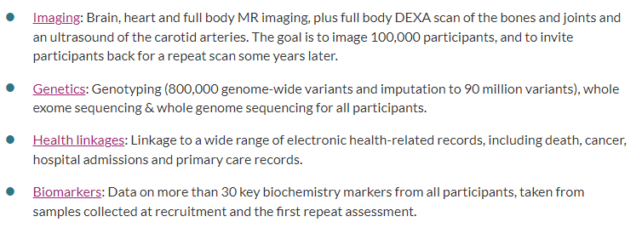
~8,000 published papers on this data to date

Slide 11
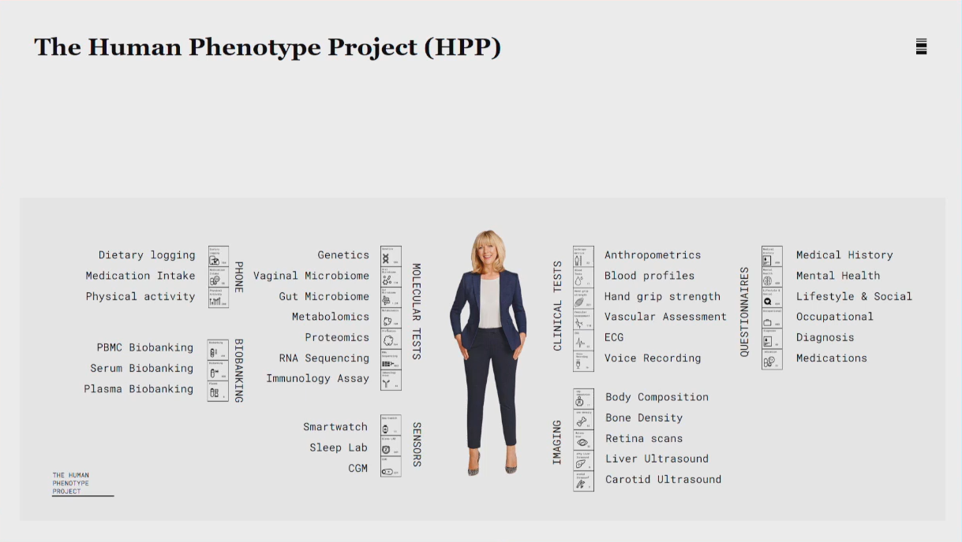
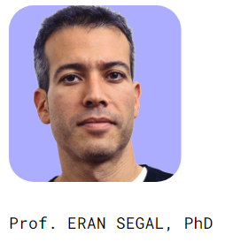
12,000 people >>> 100,000 people

Slide 12




Cases
Men younger than 70 years
Women younger than 75 years
Only Type I MI - Rise or/fall of troponin with at least one value above the 99th percentile of the upper reference limit.
423
Data available
Family history
Lifestyle factors
Smoking
Exercise
Diet
Physical parameters
Weight
Blood pressure
Oxygen sat.
Medical History
>130 quantitative variables:
Biochemical
Hematological
Previous Medical Tests
Maltese
Acute Myocardial Infarction
(MAMI) Study
Controls
Age and Sex matched to cases in 5-year age groups.
Recruited from randomly generated lists of Maltese issued by NSO.
465
Relatives of cases
210
Total of 1098 Research subjects recruited between 10th June 2011 and 30th April 2013, all of Maltese Ethnicity.
Notes:
The Maltese Acute Myocardial Infarction (MAMI) Study was set up to study epidemiological
and genetic risk factors for MI in the Maltese population. It is a collaboration between the
University of Malta and the Malta Department of Health. A total of 1098 research subjects
were recruited to this study between the 10th of June 2011 and the 30th of April 2013. Three
categories of research subjects were recruited; cases, controls and relatives of cases. All
participants were selected to be of Maltese ethnicity with Maltese parents and grandparents.

Slide 13
MAMI study – Maltese Myocardial Infarction Study – Blood Plasma
Epidemiological data
Metabolomic
Clinical data
Proteomic
10- year prospective study
Transcriptomic
Genomic
Family Data

Slide 14
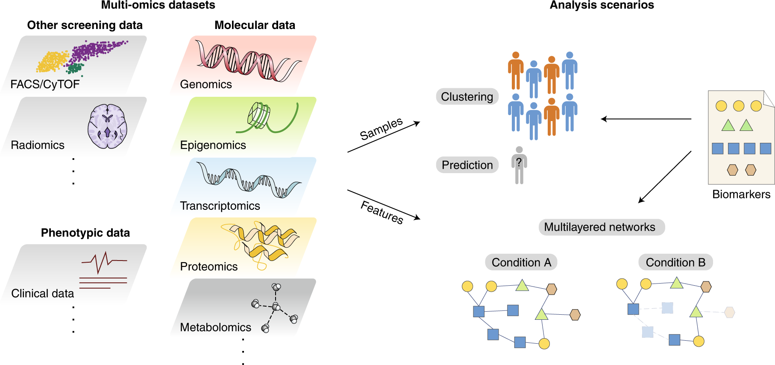
https://www.nature.com/articles/s43588-021-00086-z

Slide 15
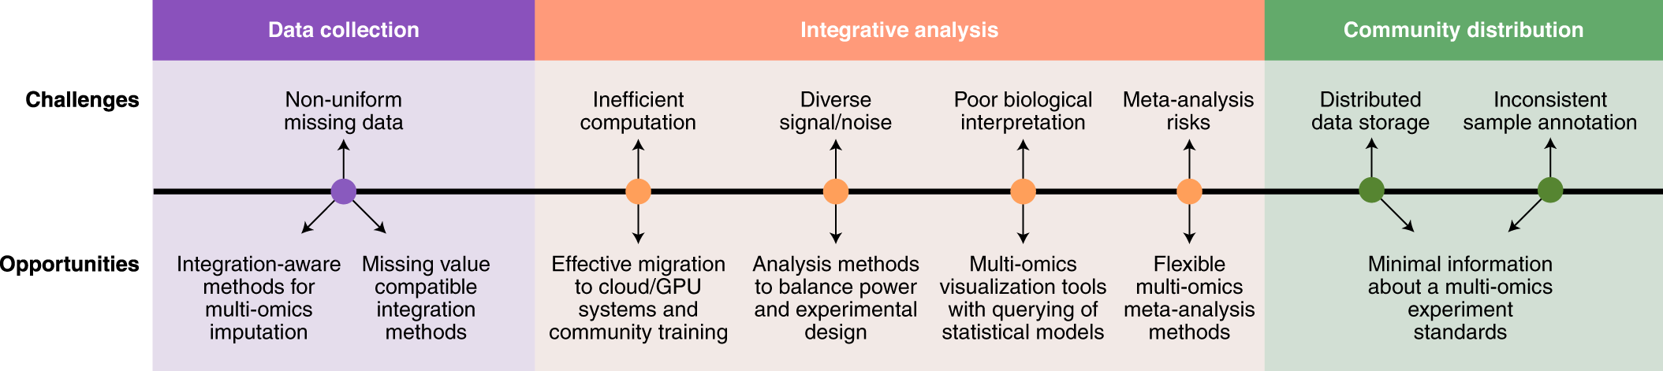
https://www.nature.com/articles/s43588-021-00086-z

Slide 16
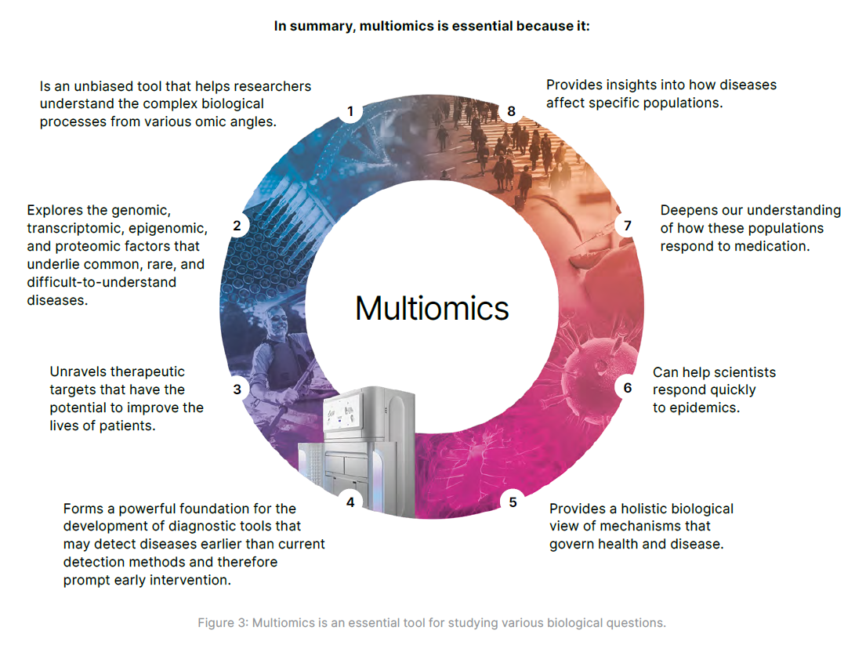

Slide 17


Slide 18
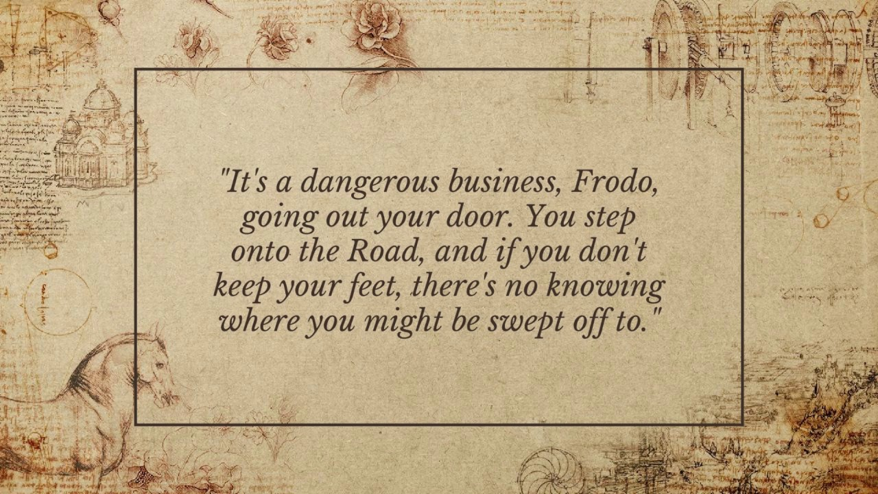

Slide 19
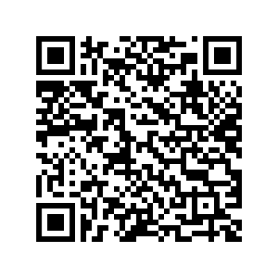

Bioinformatics at University of Malta mailing list
Bioinformatics@UM" group
https://groups.google.com/a/um.edu.mt/g/mailinglist-bioinformatics.research/about

Slide 20
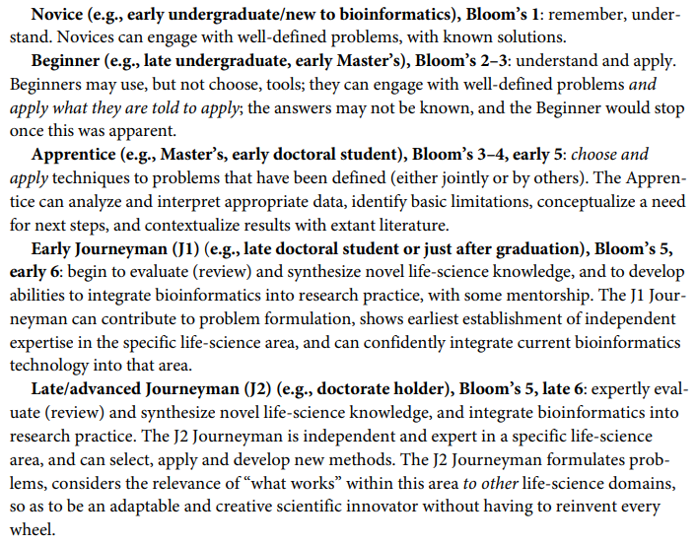
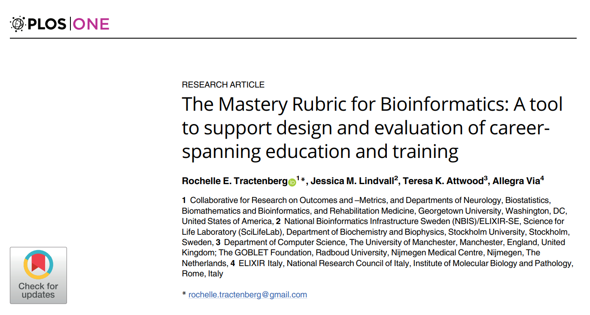
Mastery Rubric for Bioinformatics
Prerequisite knowledge—biology
Prerequisite knowledge—computational methods
Interdisciplinary integration
Define a problem based on a critical review of existing knowledge
Hypothesis generation
Experimental design
Identify data that are relevant to the problem
Identify and use appropriate analytical methods
Interpretation of results/output
Draw and contextualize conclusions
Communication
Ethical Practice

Slide 21
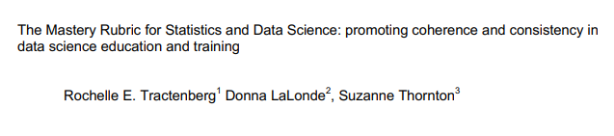
Mastery Rubric for Statistics and Data Science
Prerequisite knowledge -statistics and/or applied math
Prerequisite knowledge - computational methods
Prerequisite knowledge – in the discipline where the research questions arise
Interdisciplinary integration (statistics, computation, and the discipline/context in which these are being deployed)
Define a problem based on critical review of existing knowledge*
Hypothesis generation *
Experimental design *
Identify or collect data that is relevant to the problem/task/project *
Identify and use appropriate analytic & computational methods *
Interpretation of results/output *
Draw and contextualize conclusions *
Communication
Ethical practice
https://arxiv.org/ftp/arxiv/papers/2308/2308.08004.pdf

Slide 22
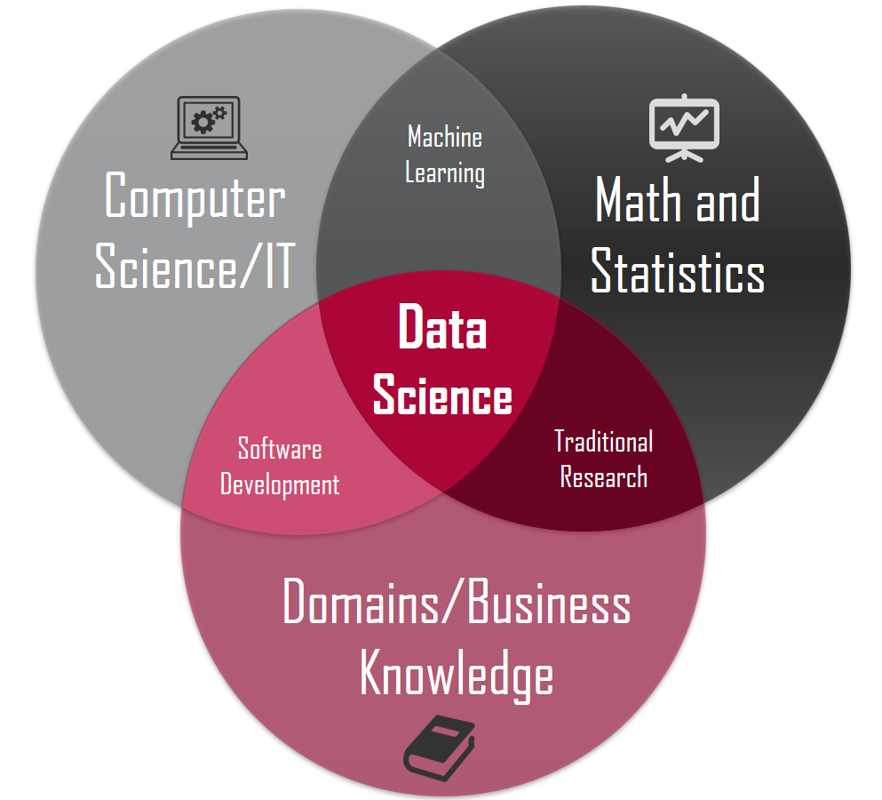
-omics

Slide 23





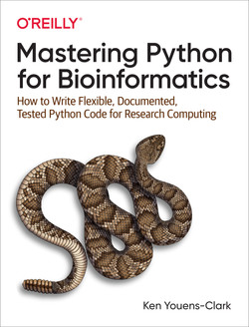
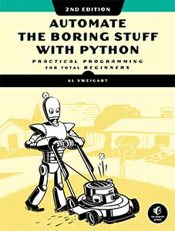

Software Development / Coding
https://automatetheboringstuff.com/#toc
http://openbookproject.net/thinkcs/python/english3e/

Slide 24
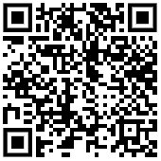

Feedback Form
Suggest future events / themes
Ask for suggestions for resources
Etc
(Resources will be sent to all attendees + mailed via bioinformatics@UM list)
https://github.com/BioGeMT/MALTAomics-Summer-School

